Slide 1

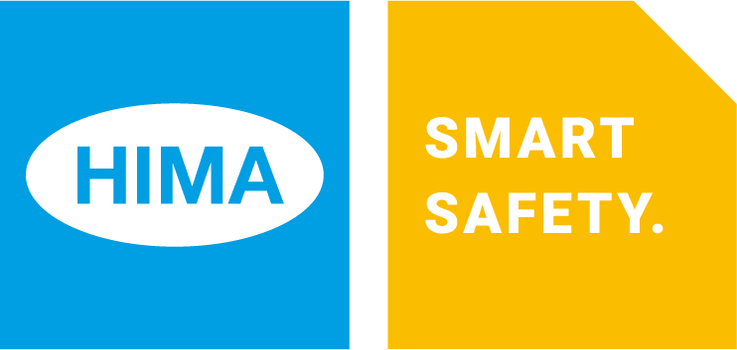
Embedded Solutions
Segment Presentation 2019

Slide 2
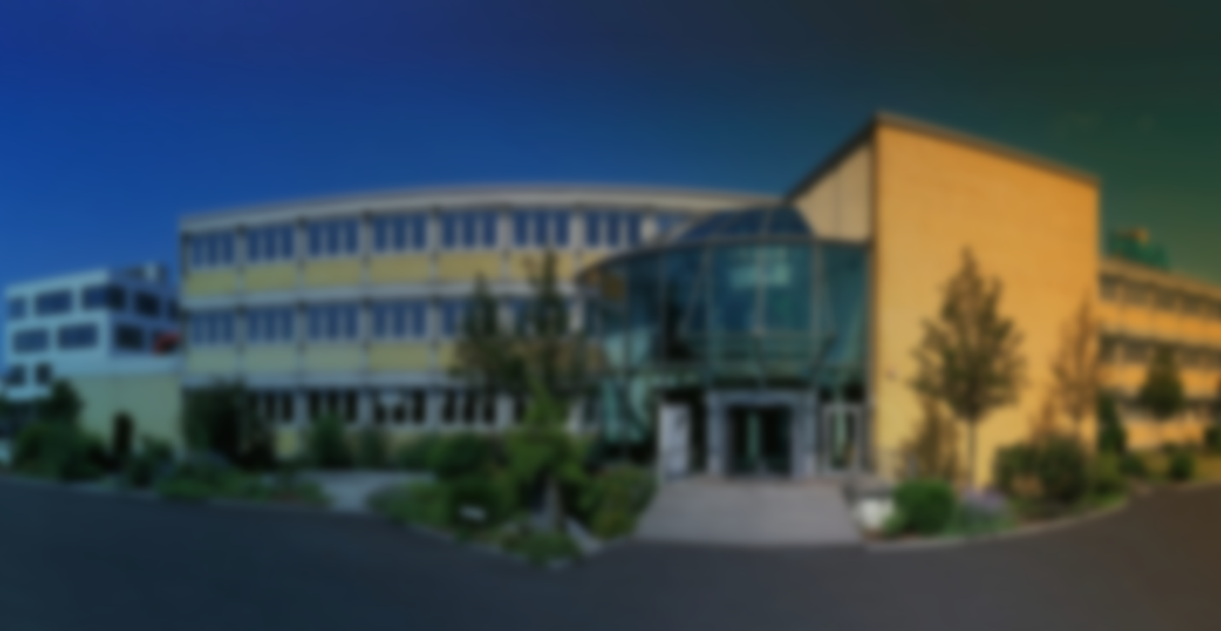
Your Expert for Safety Solutions
of experience in safety automation solutions
€123 million revenue in 2017
45
years
> 35,000 safety systems in 80 countries
> 800 employees worldwide
> 50 locations worldwide
100% Made in Germany
Notes:
The HIMA group is the world’s leading independent vendor of smart safety solutions for industrial applications. Having installed over 35,000 TÜV-certified safety systems around the world, HIMA is the industry’s technology leader. Our specialized engineers develop customized solutions that enable customers to increase functional safety, reinforce cybersecurity, and boost the profitability of their plants and factories in the digital age.
We are active around the globe and deliver quality “Made in Germany” everywhere. Many of the world’s largest companies in the oil, gas, chemical, and energy industries are our customers. And this is partly because they know that, with HIMA, they can count on over 45 years of experience in safety technology.
Embedded Solutions ist Part of the New Business-Strategy with great oppurtinities and standalone USPs for HIMA as we will see.
For HIMA, it is a totally new business case but fits perfectly with HIMA capabilites to play an outstanding role in the markets.

Slide 3
Specialized in Safety
We focus on what matters
Competitors and partners
Safety Solutions
Safety Solutions
Automation Solutions
Notes:
We specialize in safety solutions. That means that all our products are designed to help you run your industrial plants more safely.
While our “whole pie” consists entirely of safety, so to speak, our competitors and partners only give safety a piece of the pie. In other words, they provide safety solutions, but also offer a number of other automation solutions.
We are the only company that focuses exclusively on safety solutions.
We know exactly what really matters.

Slide 4
HIMA Group – Our Global Network
HIMA group companies and offices
Experienced representatives (agents)
Regional headquarters
Notes:
Where does HIMA operate?
In over 50 countries.
You can see that we are present across practically the whole world: we have group companies and offices (in blue), experienced representatives and agents (in yellow), and regional headquarters located in Brühl, Singapore, Dubai, and Houston.

Slide 5
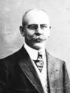
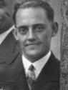

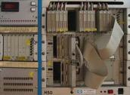

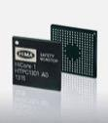

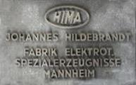
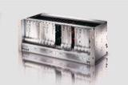
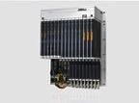

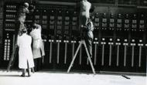

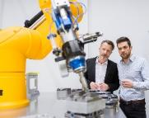
Company History
1908
1929
1936
1950
1965
1970
1986
1997
1999
2008
2013
2015
2016
2018
Notes:
It all began in 1908, when a young engineer named Johannes Hildebrandt founded a small marine engineering firm in the center of Mannheim, Germany. He dealt in all kinds of equipment for shipping on the Rhine river.
In 1929 his son, Paul Hildebrandt, took over the company. The focus of the business shifted and it began to develop its own products.
Under Paul Hildebrandt, the company focused on manufacturing control panels, pressure and temperature controls, and mercury switches. The product range was constantly expanded.
In 1936, the company was officially registered in Mannheim under the name HIMA, which stands for Hildebrandt Mannheim.
In the 1950s, the company turned to power plants and heavy industry. It started to manufacture large control panels and control and monitoring systems.
In 1965, Paul Hildebrandt’s son-in-law Bernard Philipp took the helm. He turned the company’s focus to new transistor technology. HIMA then introduced the Planar-P transistor system for industrial control and monitoring.
An incident at a production facility led to HIMA developing an electronic switch that eliminated the negative effects of faulty components and returned the system to a safe condition following a failure. This marked the beginning of safety technology by HIMA.
In 1970, HIMA launched Planar, the world’s first TÜV-certified safety system.
The next milestone came in 1986 with the development of the world’s first TÜV-certified programmable safety system: H50.
In 1997, HIMA developed the world’s first communication protocol to enable TÜV-certified safety-related communication (SIL 3) between control systems: SafeEthernet.
Steffen Philipp took over as CEO of HIMA in 1999. Under his leadership, HIMA became the world’s leading company for safety technology.
In 2008, HIMA introduced HIMax, the world’s first TÜV-certified nonstop safety system. HIMA also enters the rail industry, consequently offering the first COTS safety controller compliant to SIL 4 (CENELEC).
In 2011, HIMA creates the world’s first SIL 3/PL e system for safe distance measurement. With it HIMA proves its safety expertise in areas other than the rail and process industries.
In 2013, HIMA revolutionized the safety technology market with the launch of the HICore system, the world’s first chip-based SIL 3 safety system.
2015 – Three years after HIMA first entered the rail market, the company founds the HIMA Rail Industry Segment. Its creation in 2015 marks the beginning of a joint strategy involving system integrators and OEMs with a goal to establish COTS in rail safety worldwide.
2016 – HIMA changes its portfolio to adapt early to new demands and challenges in a digitized industry. The product-focused company becomes a solution provider, emphasizing its full range of systems, applications, services, and safety consulting.
2017 – As digital transformation progresses, HIMA transforms into a vendor of smart safety solutions. For HIMA, this means continuously investing in new technology, such as modular, networked, and manageable systems. As a result, customers are not just offered a product – they instead receive a tailored, all-in-one solution with first-class consulting and services.
2018 – HIQuad X arrives on the market and will be used in the Smart Safety Platform – the world’s first combination of hardware and software that integrates functional safety and cybersecurity in a single system.
In the same year HIMA launches its new Embedded Solutions Business Segment based on HICore technology. For the first time, customers can quickly develop compact safety solutions for their individual applications.

Slide 6
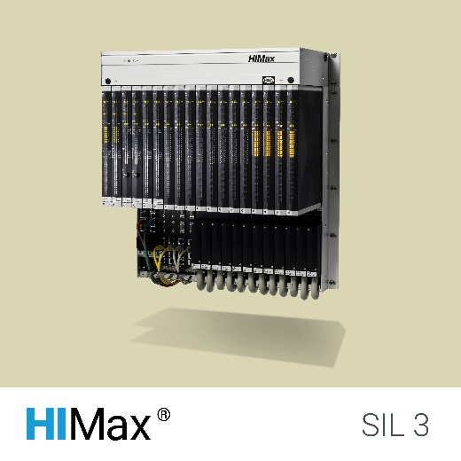
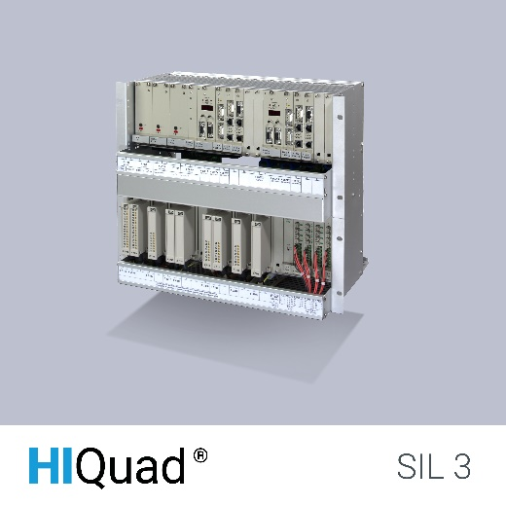
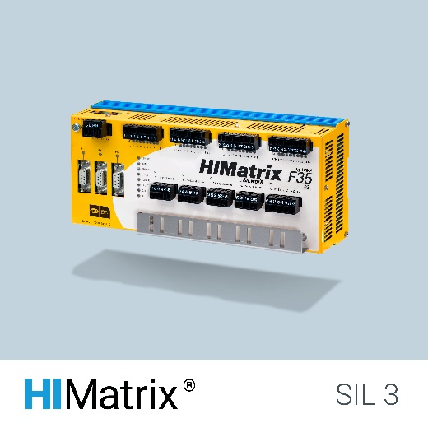
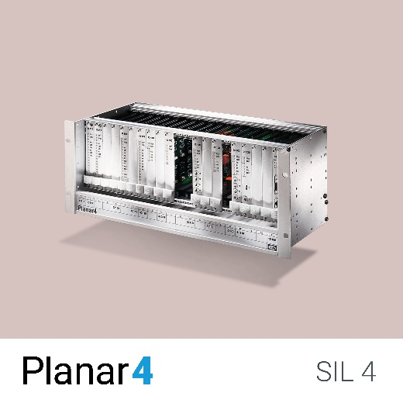
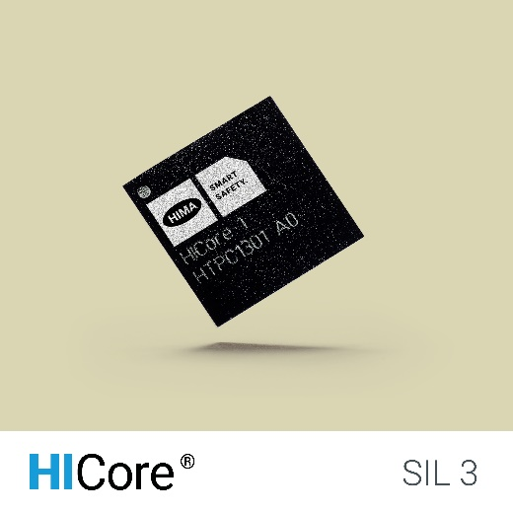
HIMA Safety Systems
HIMax – Certified up to SIL 3, PL e, SIL 4 CENELEC
HIQuad (X) – Certified up to SIL 3
HIMatrix – Certified up to SIL 3, PL e, SIL 4 CENELEC
Planar4 – Certified up to SIL 4
HICore – Certified up to SIL 3, PL e
Notes:
This is our standard product family as it is know today. As you see, HIMA focusses on Safety Solutions with High Demands
DE
______________________________
Hier sehen Sie alle unsere Sicherheitssteuerungen.
Sie sind einsetzbar bis SIL 3 bzw. SIL 4 nach CENELEC für die Bahnindustrie. Unsere fest verdrahtete Sicherheitssteuerung Planar4 ist sogar bis SIL 4, die höchste Sicherheitsstufe überhaupt, zugelassen.

Slide 7


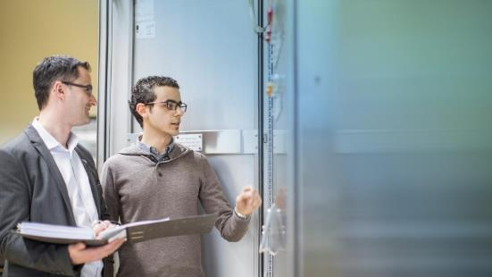
HIMA Business Segments
Process Industry
Applications in the oil and gas industry
Petrochemicals
Chemicals
Pharmaceuticals
Energy
Etc.
Rail Industry
Level crossings
Railway signaling
Power supply
Rolling stock
Automatic train control systems
Etc.
Services
Consulting services
Engineering services
On-site safety services
Service agreements
Training and qualification
Notes:
Let’s take a more detailed look at our business segments.
Our main business comes from the process industry. It’s what made us into a major player. We’ve been working in this sector for 45 years.
It’s also where our biggest customers work.
Since the mid 2000s, our second key industry has been the rail sector. This market is growing in importance for us.
We serve large, important companies here, too.
Services play an increasingly important role in providing safety to our customers. That’s why we created a business segment for it, that stands on its own.

Slide 8
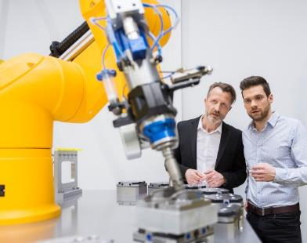
HIMA Launches the Embedded Solutions Business Segment
2018
HIMA opens its Embedded Solutions Business Segment.
For the first time, customers are able to develop compact safety solutions for their applications based on HICore technology.
© HIMA Group
8
Notes:
HIMA has also been operating in the embedded solutions business for quite some time.
Due to the HICore technology HIMA offers safety solutions for SoC (safety-on-chip) applications.

Slide 9
Your Partner for Embedded Safety Development
EXPERIENCE Experts in safety automation solutions
INFRASTRUCTURE We can perform the full scope of functional safety management
45
years
RESOURCES Capability for full scope of product development
LIFECYCLE We support the whole product lifecycle
MANAGEMENT Experienced safety project management
STANDARDS Expertise with all conventional standards

Slide 10
Embedded Solutions
2 locations
> 15 developers and engineers
Facts
Team
Hardware designer
Software developer
Application engineers
Locations
Brühl, Germany HIMA Headquarters: sales, engineering & production
Kassel, Germany; HIMA Location: development, testing and documentation
Expertise and Resources
Full scope of functional safety development
Full access to all operational HIMA resources
100% developed and produced in Germany
> 15 years long-term availability of product family

Slide 11
Embedded Solutions: Our Market Approach
Customers
product
100% of our customers returned with additional projects
Design
House
Notes:
At Embedded Solutions, we focus at customer specific products marketed by the customer under his brand. Access to these customers is:
The direct custumer path
The path through design houses

Slide 12
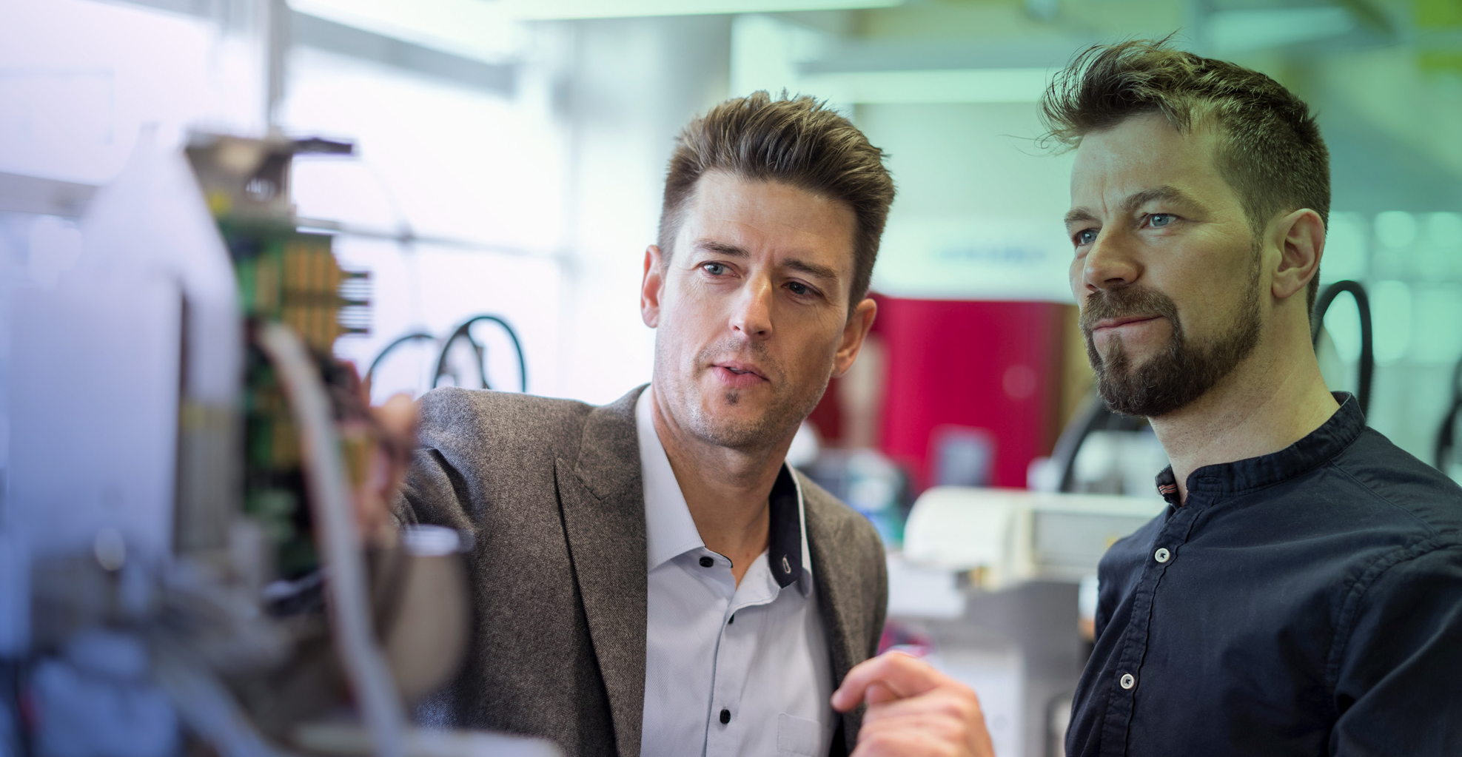
Fulfilling Safety Requirements with HIMA Embedded Solutions
Customized designs
based on the HICore technology platform
Functional Safety
integrated into your systems
Flexible solution design
with HIMA Embedded Solutions
Seamless integration
of solutions into your systems

Slide 13
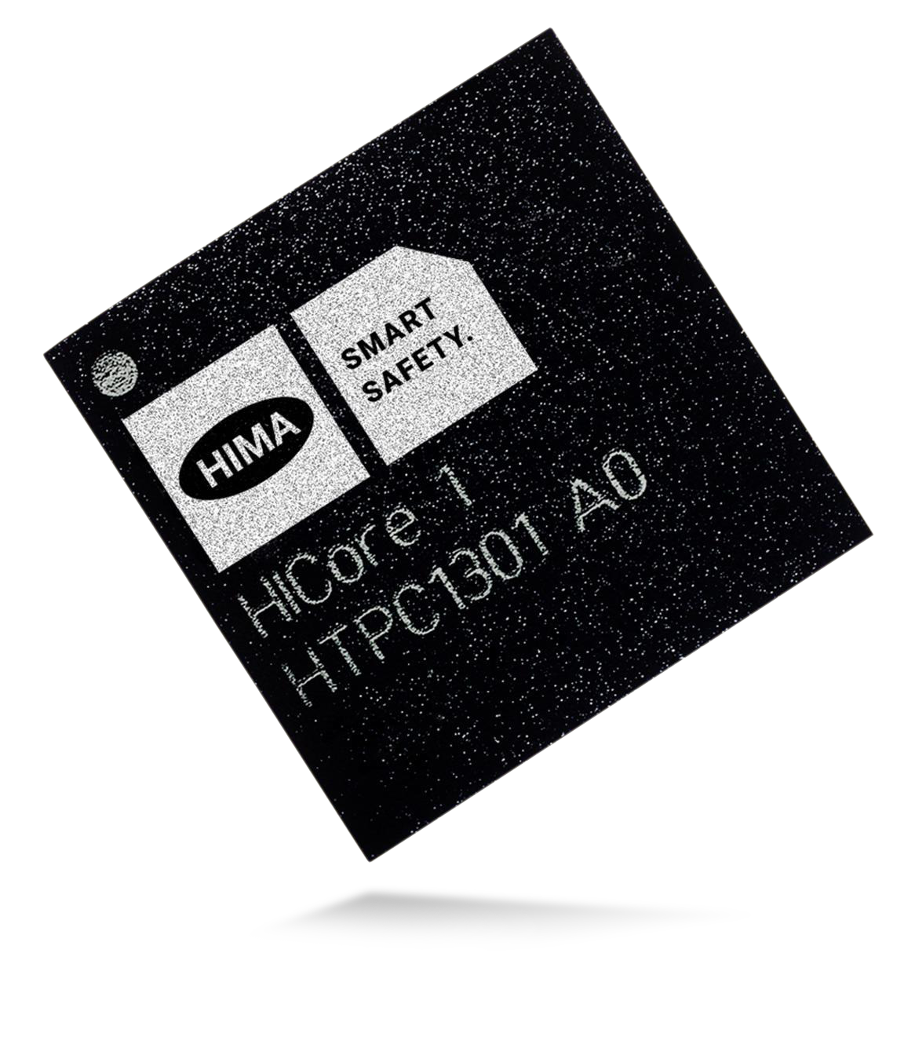
HICore - The Core of Your Safety System
Complete on-chip safety system
Including safe operating system
Middleware abstracts hardware from customer application
Pre-certified according to IEC 61508 and ISO 13849-1 up to SIL3 and PLe

Slide 14
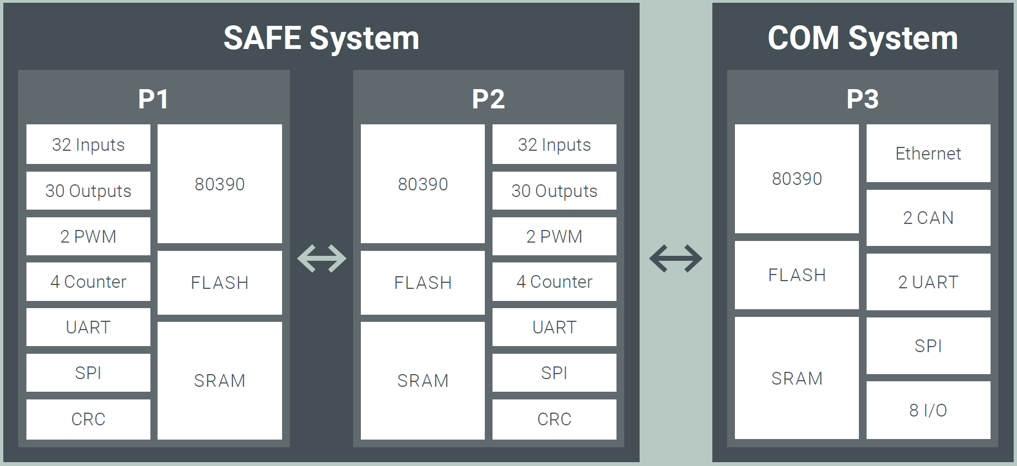
HICore 1 Architecture
Three high-performance 8-bit CPUs @ 100 MHz
Independent, integrated memory and flash for all three CPUs
Separate power domains in safe system for P1 & P2
Up to 64 in- and 60 outputs, 2 PWMs & 8 counters
Ethernet, CAN & UART interfaces
SPI interfaces for additional on-board peripherals
Notes:
Three high-performance 8-bit CPUs @ 100 MHz
Independent, integrated memories and flash for all three CPUs (2x 256KB / 1x 512KB Flash + 2x 64KB / 1x 128KB SRAM)
Separate power domains in safe system for P1 & P2
Up to 64 in- and 60 outputs, 2 PWMs & 8 counters up to SIL3
Ethernet, CAN & UART interfaces
SPI interfaces for additional on-board peripherals

Slide 15
HICore 1 Architecture
Notes:
Three high-performance 8-bit CPUs @ 100 MHz
Independent, integrated memories and flash for all three CPUs (2x 256KB / 1x 512KB Flash + 2x 64KB / 1x 128KB SRAM)
Separate power domains in safe system for P1 & P2
Up to 64 in- and 60 outputs, 2 PWMs & 8 counters up to SIL3
Ethernet, CAN & UART interfaces
SPI interfaces for additional on-board peripherals

Slide 16
HICore 1 Architecture
Customer Application
Middleware
Safe Comms
Independent non-reactive communications sub-system
All functional safety aspects of system covered by IC and OS
HICore OS
HICore SoC
Watchdog
Notes:
HICore 1 OS covers all aspects of platform safety (self tests, …).
HICore 1 middleware abstracts hardware from customer application. No register level programming required / permitted!

Slide 17
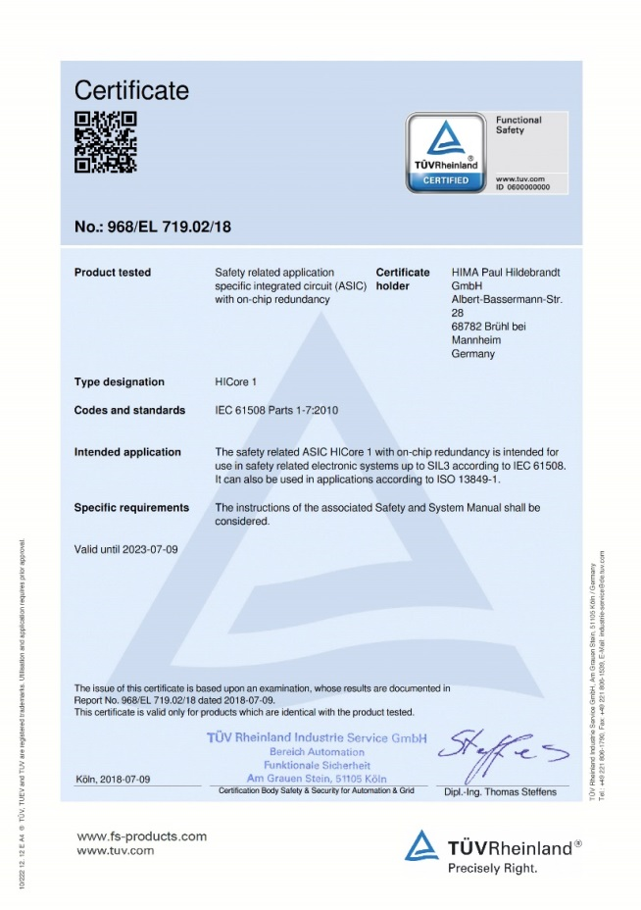
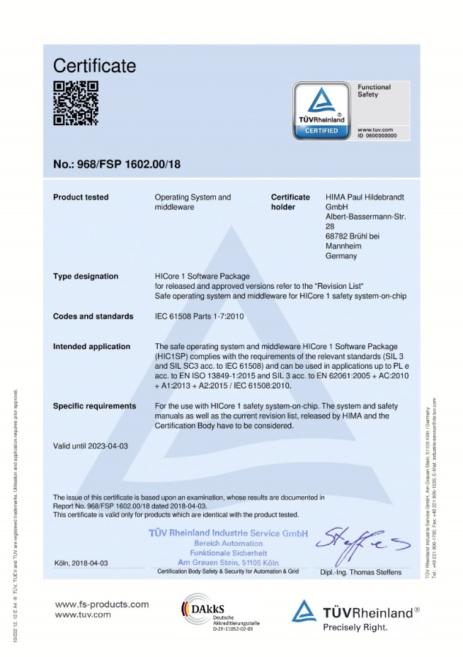
The Certified Solution for Your Application
Complete on-chip safety system – SIL 3 certified (IEC 61508, Ed. 2, Parts 1–7)
Proven HIMA 1oo2 safety-PLC architecture – on a single chip
Certified HIMA OS (IEC 61508 Ed. 2, SIL3)
Certified HIMA middleware (IEC 61508 Ed. 2, SIL3)

Slide 18
HIMA Supports You throughout the Entire Lifecycle
Design phase
Market introduction
Scaling sales
Market introduction
Component maturity
Last time buy
Long-term storage
Lifecycle of industrial safety products
Lifecycle of semiconductors
- 3a
0
+ 3a
+ 6a
time [a]
Design phase
Marketing phase

Slide 19
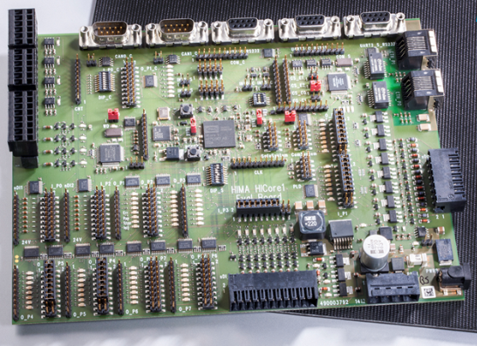
HICore HTPC1301 Evaluation KIT
Evaluation-Kit contains:
Evaluation Board (full I/O)
Power Supply
Antistatic mat
Documentation
Certified ASIC
Certified OS
Tools
Examples

Slide 20
Safety – from Concept to Core and Certification
Embedded Solutions
Services
Modular Tailored to your needs
1
2
3
Custom Designs Full scope of hardware and software design
Notes:
Wir bieten qualiﬁzierte, durchdachte und aufeinander abgestimmte Dienstleistungen für alle Phasen des Sicherheitslebenszyklus.
Wir besitzen das Safety-Know-how, das auf Planer- oder Kunderseite oft nicht (mehr) vorhanden ist.
Aufgrund unserer Unabhängigkeit können wir in jeglicher Projektkonstellation arbeiten:
Wir übernehmen Teilaufgaben oder ganze Projekte und arbeiten sowohl für Endkunden als auch im Team mit Designhäusern.
Unabhängigkeit heißt aber auch: Wir verkaufen Ihnen nicht die Systeme, die uns irgendein Hersteller vorschreiben will. Sondern wir erarbeiten ein Sicherheitskonzept, das Ihre individuellen Anforderungen ideal erfüllt.
Wir möchten schließlich, dass Sie bei uns bleiben.
Safety SoC as a complete kit HICore is provided as a complete and certified kit: IC, operating system, middleware and documentation.
Consulting HIMA assists with selecting the right components, methods and solutions for your safety product.
Engineering Hard- and software design can be supported or provided by HIMA.
Certification HIMA assists with the complete TÜV certification process – or even certify with TÜV.
Production HIMA’s certified production line can be utilized for customer designs. This will ease and accelerate the certification process.

Slide 21
Embedded Solutions – Services (Development)
Consulting & Specification HIMA can assist with selecting the right components, methods and solutions
Engineering Hard- and software design can be supported or provided by HIMA
Certification HIMA can assist with the complete TÜV certification process – or even certify with TÜV for you
Support Hard- and software design support

Slide 22
Embedded Solutions - Services (Production & Supply)
Supply HICore is always provided as a complete and certified kit: IC, operating system, middleware and documentation.
Production HIMA’s certified production line can be utilized for customer designs. This will ease and accelerate the certification process.
Production support (1) Customers with an own production line can be supported by HIMA with unique Know-How to shorten the programming- & test time for their OEM-product based on HICore.
Production support (2) The HICore ASIC could be ordered preprogrammed with customer specific application code.

Slide 23

Advantages HIMA Embedded Solutions
Modular services
Long-term partnership
Hardware design
Flexible business model
Software design
Long-term availability
Certification
Functional safety management
Production

Slide 24








Embedded Solutions: A Few of Our Customers
Notes:
HIMA Embedded Solutions has many reference projects in the field of electrical and drive technology.
Further fields of application are robotics and medical technology.

Slide 25
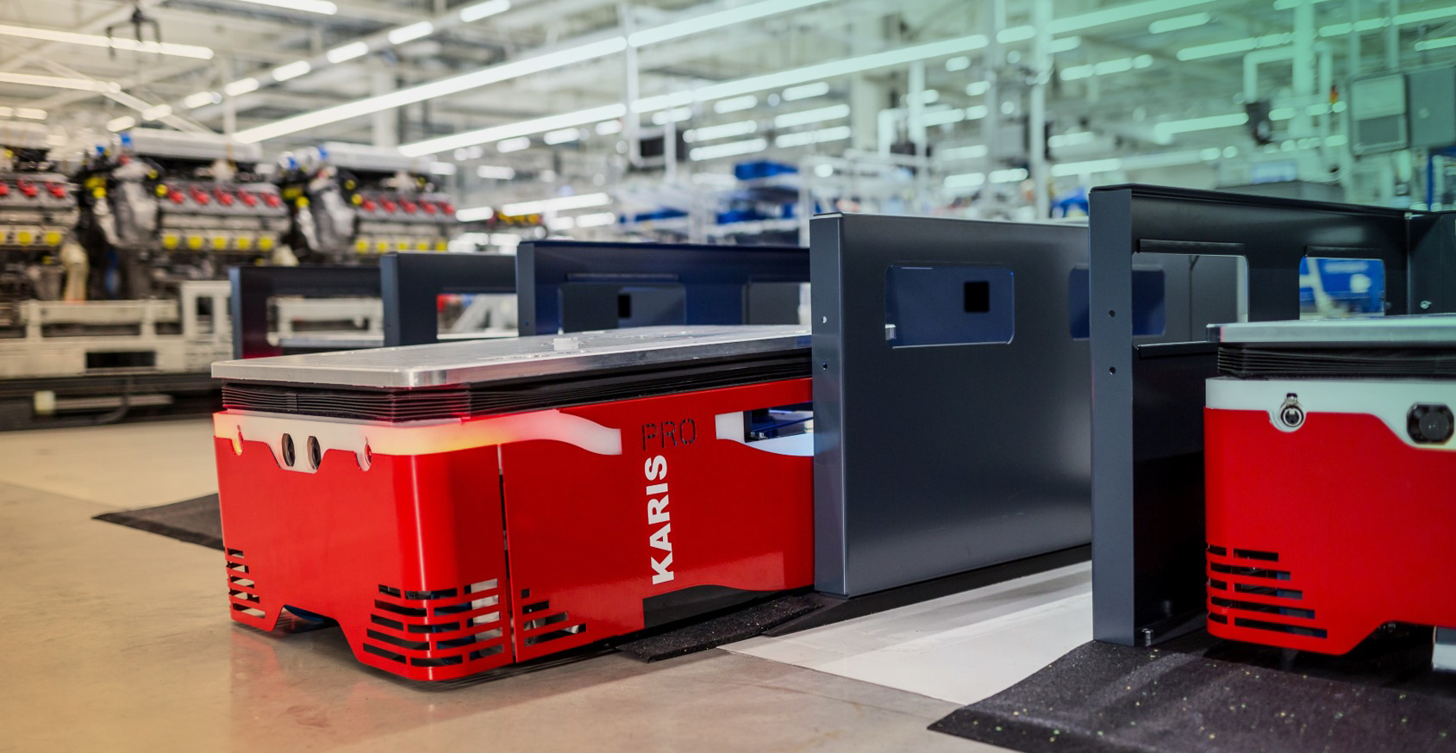
Safety Functions for AGV
© Audi Sport
Notes:
What are the current challenges in times of Industry 4.0?
Today, systems in the smart factory environment communicate with each other, machines control themselves and processes become more and more agile.
HIMA and the Karlsruhe Institute of Technology (KIT) have developed a safe control technology for driverless transport systems in the Smart Factory Automation. The basis is the innovative and compact HICore Safety-on-Chip (SoC) technology. The driverless transport system KARIS can be used instead of rigid, inflexible systems such as roller conveyors and conveyor belts. It identifies obstacles, can interact with people safely, and communicate securely with other machines.
DE
____________________________________________
Was sind die aktuellen Herausforderungen in Zeiten von Industrie 4.0?
Heute kommunizieren in der Smart Factory Anlagen miteinander, Maschinen steuern sich selbst und Prozesse werden immer agiler.
Zusammen mit dem Karlsruher Institut für Technologie (KIT) haben wir eine sichere Steuerungstechnik für fahrerlose Transportsysteme in der Smart Factory entwickelt.
Basis ist der kompakte HICore-Chip, über den wir eben schon gesprochen haben.
Das KARIS-System kann man anstelle starrer, unflexibler Systeme wie Rollenförderer und Förderbänder einsetzen. Es erkennt Hindernisse, kann mit Personen sicher interagieren und mit anderen Maschinen sicher kommunizieren.

Slide 26

KARIS PRO
Drives integrated with safety functions according to IEC 61800
Collaboration Partners
Karlsruher Institut für Technologie (KIT)
HIMA Paul Hildebrandt GmbH
SEW-Eurodrive GmbH & Co. KG
ebmPapst St. Georgen GmbH & Co. KG
HIMA’s Scope of Service
Performance analysis
Hardware and software design
Development in collaboration
Integrated safety functions including Safe Brake Control, Safely Limited Speed, Safely Limited Position Safe Torque Off
Safe communication achieved by decentralized automation topologies with CANopen Safety
HICore Unique Selling Point
Extreme high integration density
High temperature range
Notes:
In the KARIS PRO collaboration project, HIMA integrated drives with safety functions in accordance with IEC 61800 via HICore1.
The integrated safety functions included Safe Brake Control, Safely Limited Speed, Safely Limited Position, and Safe Torque Off.
Safe communication was also implemented via decentralized automation topologies with CANopen Safety.

Slide 27
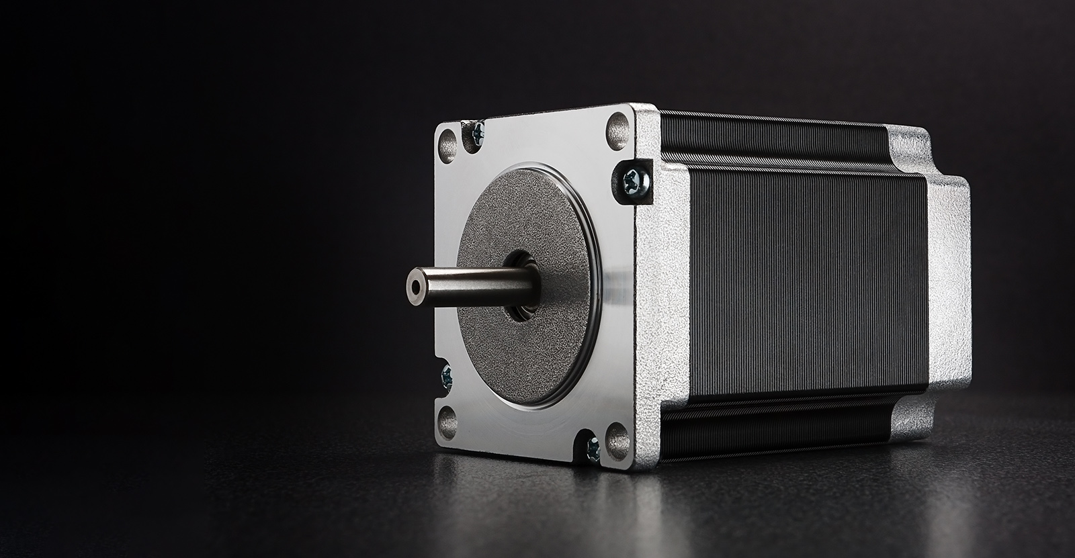
Safety Functions for Drives

Slide 28
STÖBER Antriebstechnik GmbH & Co KG
Drive controller adding SIL 3 safety functions according to IEC 61508 to standard controllers
Safety Functions
Safe Torque Off, Safe Stop 1
Safe communications
Fail Safe over EtherCAT (FSoE)
PROFIsafe over PROFInet
more prepared
HIMA’s Scope of Service
Performance analysis
Hardware and software design
Development and production
Certification according to IEC 61508
14 months from start to certification with full scope of services
3 follow-up projects due to customer satisfaction
HICore Unique Selling Point
SIL 3 certified according to IEC 61508
Extreme high integration density
HICore as scalable platform for further safety functions and safe communications
Notes:
The project was to develop an embedded safety module for electrical drive controllers.
We added SIL 3 safety functions in accordance with IEC 61508 to standard controllers.
The entire project took 14 months to complete, from the start up to certification with the full scope of services.
The customer was satisfied with the results and this led to three follow-up projects.

Slide 29
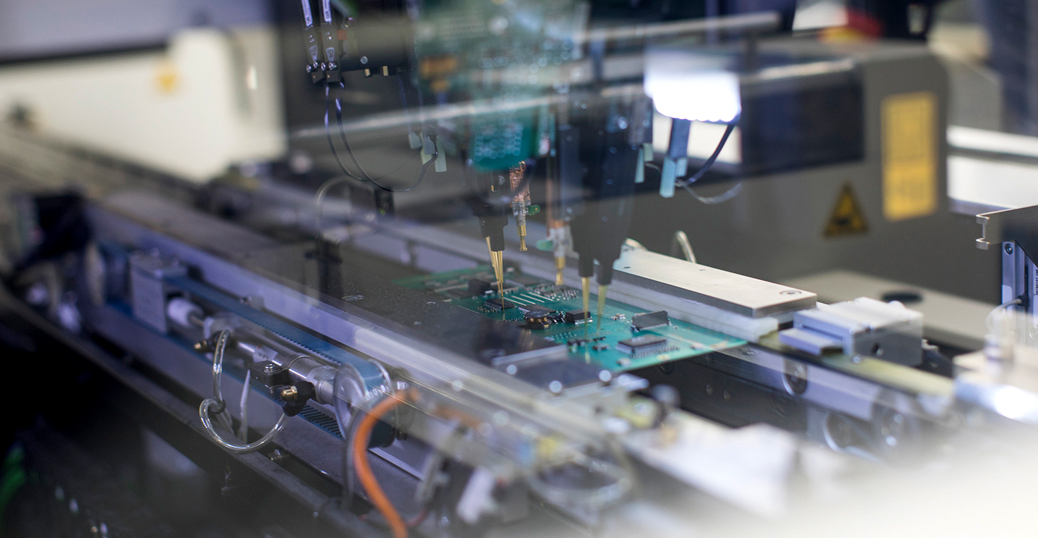
Safety Functions for Sensors

Slide 30
Pepperl + Fuchs GmbH
Safe sensor customer specified safety solution
Safety Functions
Safe absolute positioning
Safe communications
PROFIsafe over PROFInet
more prepared
HIMA’s Scope of Service
Performance analysis
Hardware and software design
Development and production
Certification according to IEC 61508
1.5 years from start to certification
more follow-up projects planned due to customer satisfaction
HICore Unique Selling Point
SIL 3 & PLe certified according to IEC 61508 and ISO 13849-1
Very small footprint needed
Extreme high integration density
HICore as scalable platform for further safety functions and safe communications
Notes:
We worked with Pepperl + Fuchs GmbH to develop a safe positioning sensor which included safe communication for automation applications.
This was a customer specified safety solution.
It took us one and a half years, from the beginning up to certification, to complete.

Slide 31
Thank You.
HIMA Paul Hildebrandt GmbH
Albert-Bassermann-Str. 28
68782 Brühl, Germany
Phone: +49 6202 709-0
Fax: +49 6202 709-250
E-mail: hicore@hima.com
Internet: www.hima.com

